Slide 1
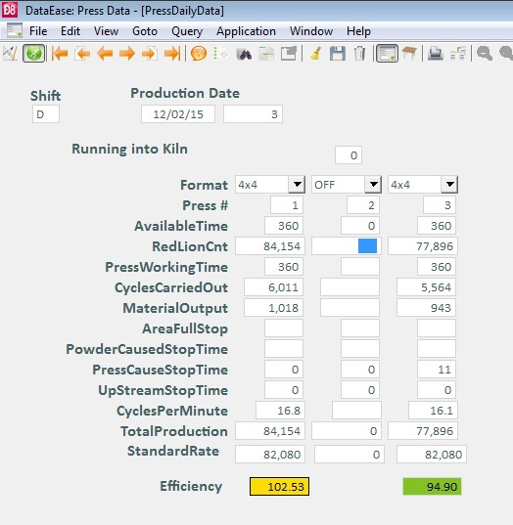
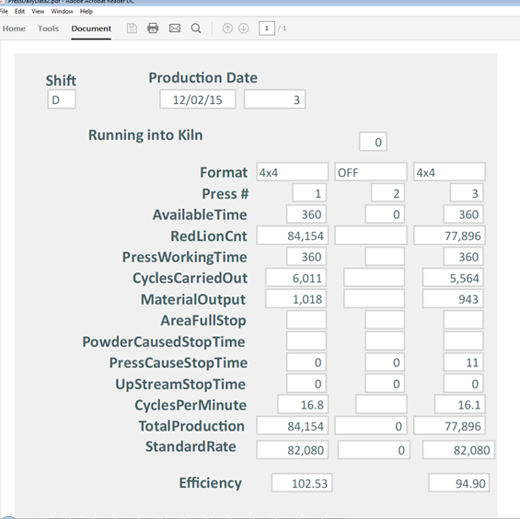
Screen shot from DE
PDF of the same Record

Slide 2
